Slide 1


Image Classification For Cross Analysis of Chest X-Rays
Reference:
https://github.com/Stephensingletary/Image-Classification-For-Cross-Analysis-of-Chest-X-Ray
Presented by:
Nathan, Stephen, Aleks, Pat, Bab
Notes:
Stephen

Slide 2
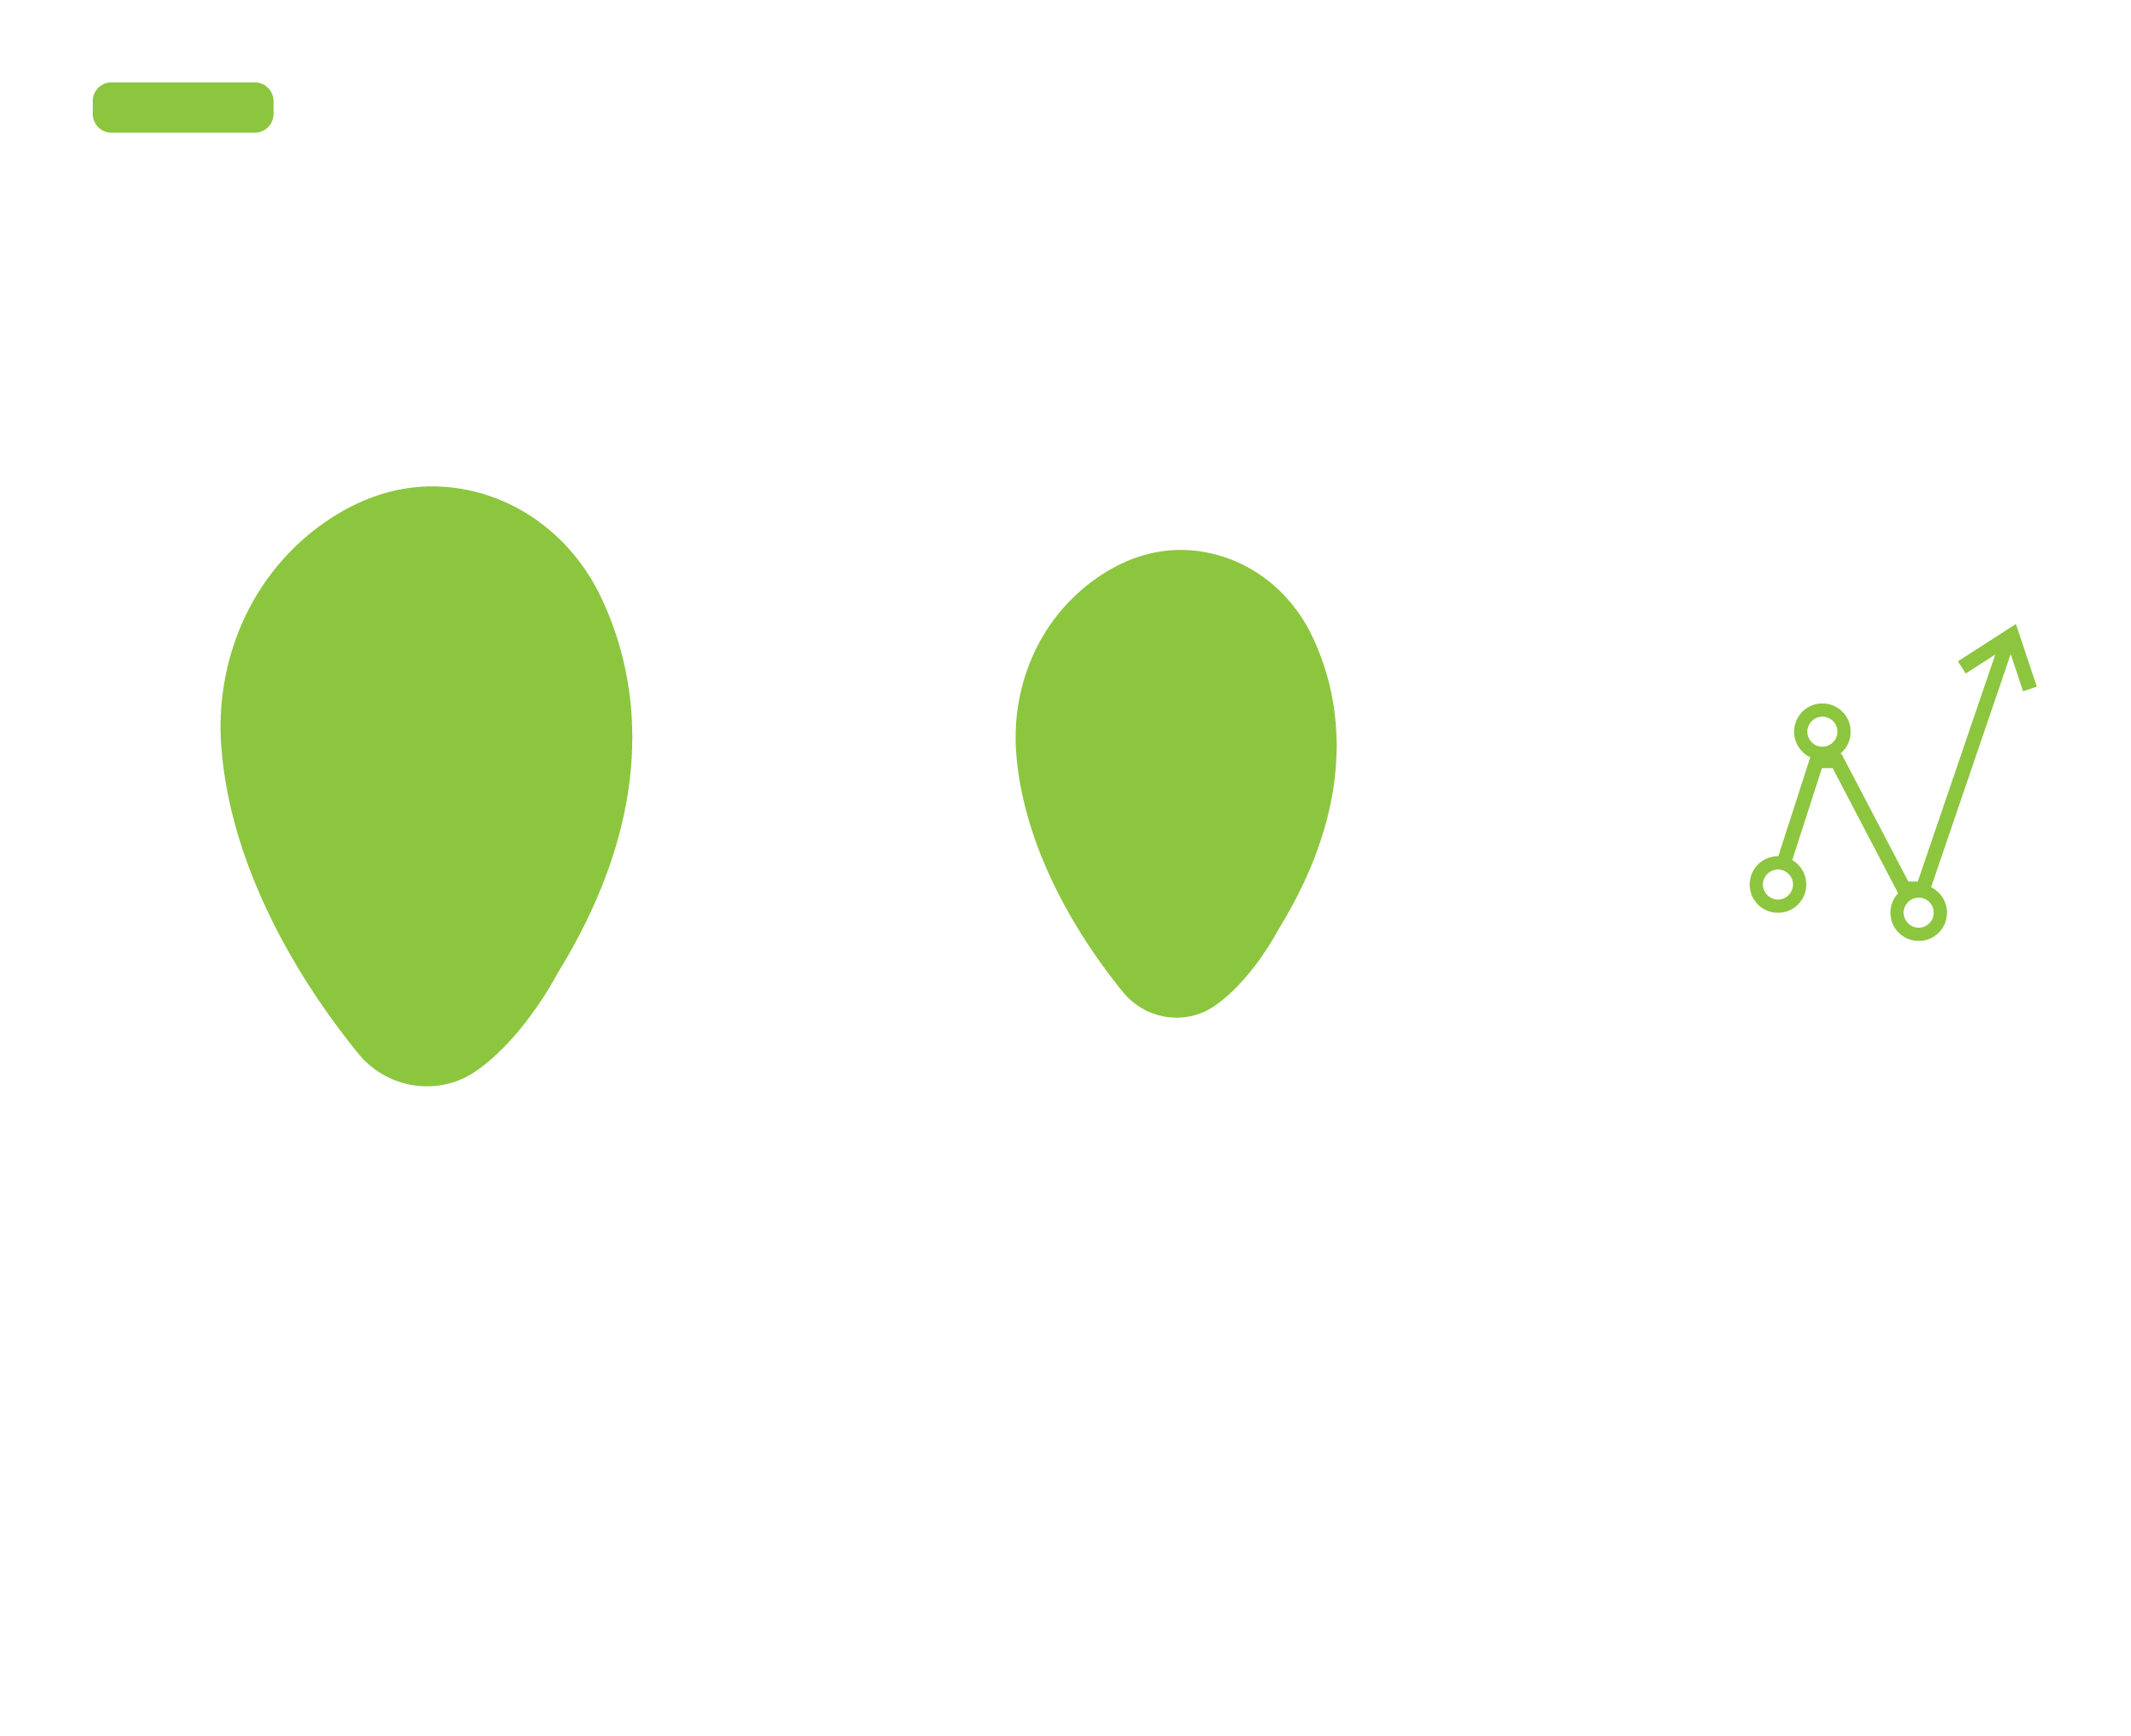
Project Overview:
Problem:
Medical professionals often spend a large amount of time analyzing X-ray images in order to diagnose specific pathologies on time and treat them earlier to prevent them spreading from bad to worse.
Solution:
Our image classifier performs analysis to determine whether or not a pathology is likely to be present in order to save time and increase individual productivity.
Notes:
Stephen

Slide 3

Project Process
Integration
Model Training
Cleaning Data
Model Selection
Data
Collection
Notes:
Stephen

Slide 4

Data Overview
Data Collection
Data Source: https://nihcc.app.box.com/v/ChestXray-NIHCC/folder/36938765345
Overview
One of the largest publicly available chest X-ray datasets, curated by the National Institutes of Health.
Key Features
Size: 112,120 frontal-view chest X-ray images.
Patients: 30,805 unique patients
Images: provided at a resolution of 1024x1024 pixels,
The dataset includes annotations for 14 common thoracic diseases
Notes:
Patrick

Slide 5
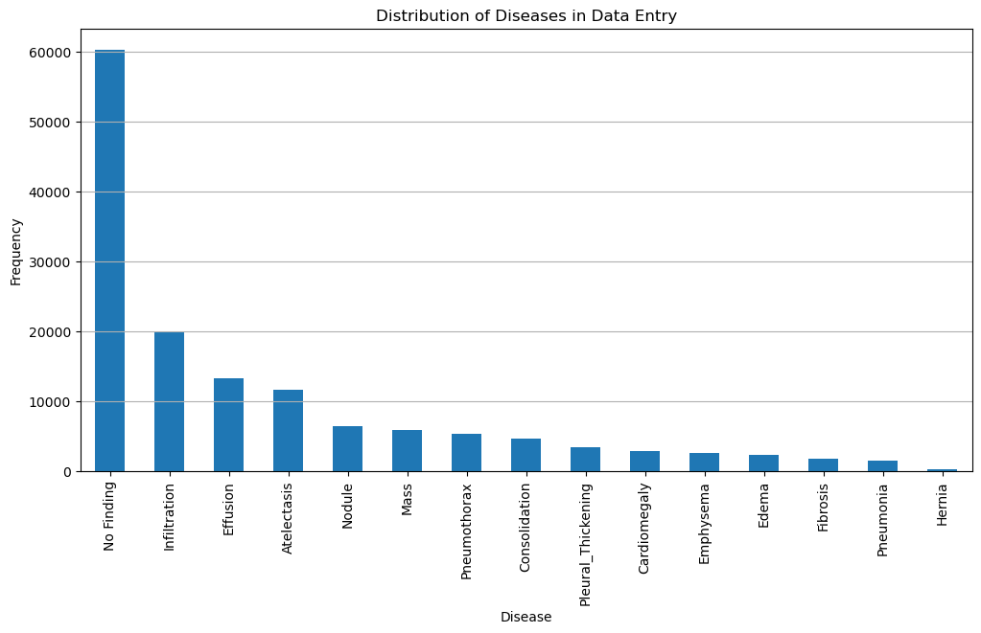
Data Overview
Data Processing Steps
1. Data Loading
2. Image Paths
3. Initial Data Inspection
4. Image Mode Analysis
5. DataFrame Merging
6. Data Balancing
7. One-Hot Encoding
8. Patient Age Cleaning
9. Categorical Encoding
10. Dropping Unnecessary Columns
11. Exploratory Data Analysis (EDA)
12. Saving Cleaned Data
Notes:
Patrick

Slide 6







Methodology and Model Development
Notes:
Aleks

Slide 7
Methodology and Model Development
Training Parameters
Class Train detection model
Data Augmentation
Class Weights
Training Parameters
Model Architecture
Output: .keras
Computed to handle class imbalance
Optimizer: Adam
Learning Rate: 0.001
Loss Function:
Binary Crossentropy
Batch Size: 32
Epochs: 10
Rotation Range: 20 dgrs
Width Shift Range: 0.2
Height Shift Range: 0.2
Horizontal Flip: True
Image size 256x256 pixels
Conv2D ReLU activation
MaxPooling2D
Dense layer 256 neurons, ReLU activation
Training Set Size | 16,563 images
Test Set Size | 4,141 images
Total Training Time | ~5 hours
Hardware | Local CPU
Notes:
Aleks

Slide 8
Model Performance
Model Evaluation and Optimization
Test Accuracy
Poor
50.2%
Test Loss
Poor
0.695
Training Time
local CPU
5H
No Finding
Precision: 0.00
Recall: 0.00
F1-score: 0.00
Support: 10,304
Finding
Precision: 0.50
Recall: 1.00
F1-score: 0.67
Support: 10,400
Classification Report
Macro Average:
Precision: 0.25
Recall: 0.50
F1-score: 0.33
Overall Accuracy: 50.23%
Notes:
Aleks

Slide 9
Implementation and Application
CNN Model:
Keras (.keras) file saved in notebook to allow for easy implementation without the need for lengthy training on individual machines.
Gradio Application:
Inputs:
Random Image From Dataset
User-Specified Image
Outputs:
Is pathology likely to be present?
Google Text-To-Speech Readout
Notes:
Nathan

Slide 10
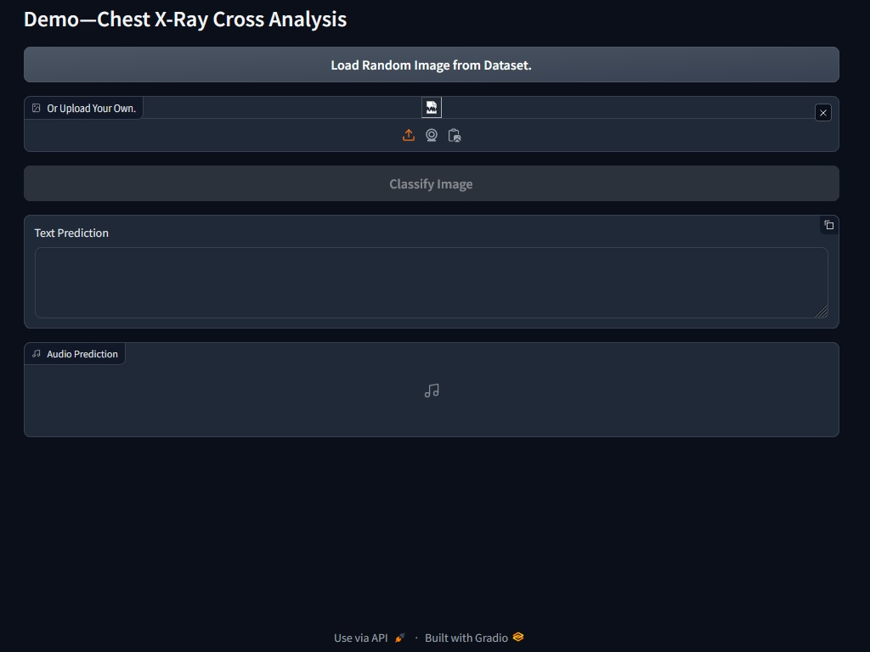
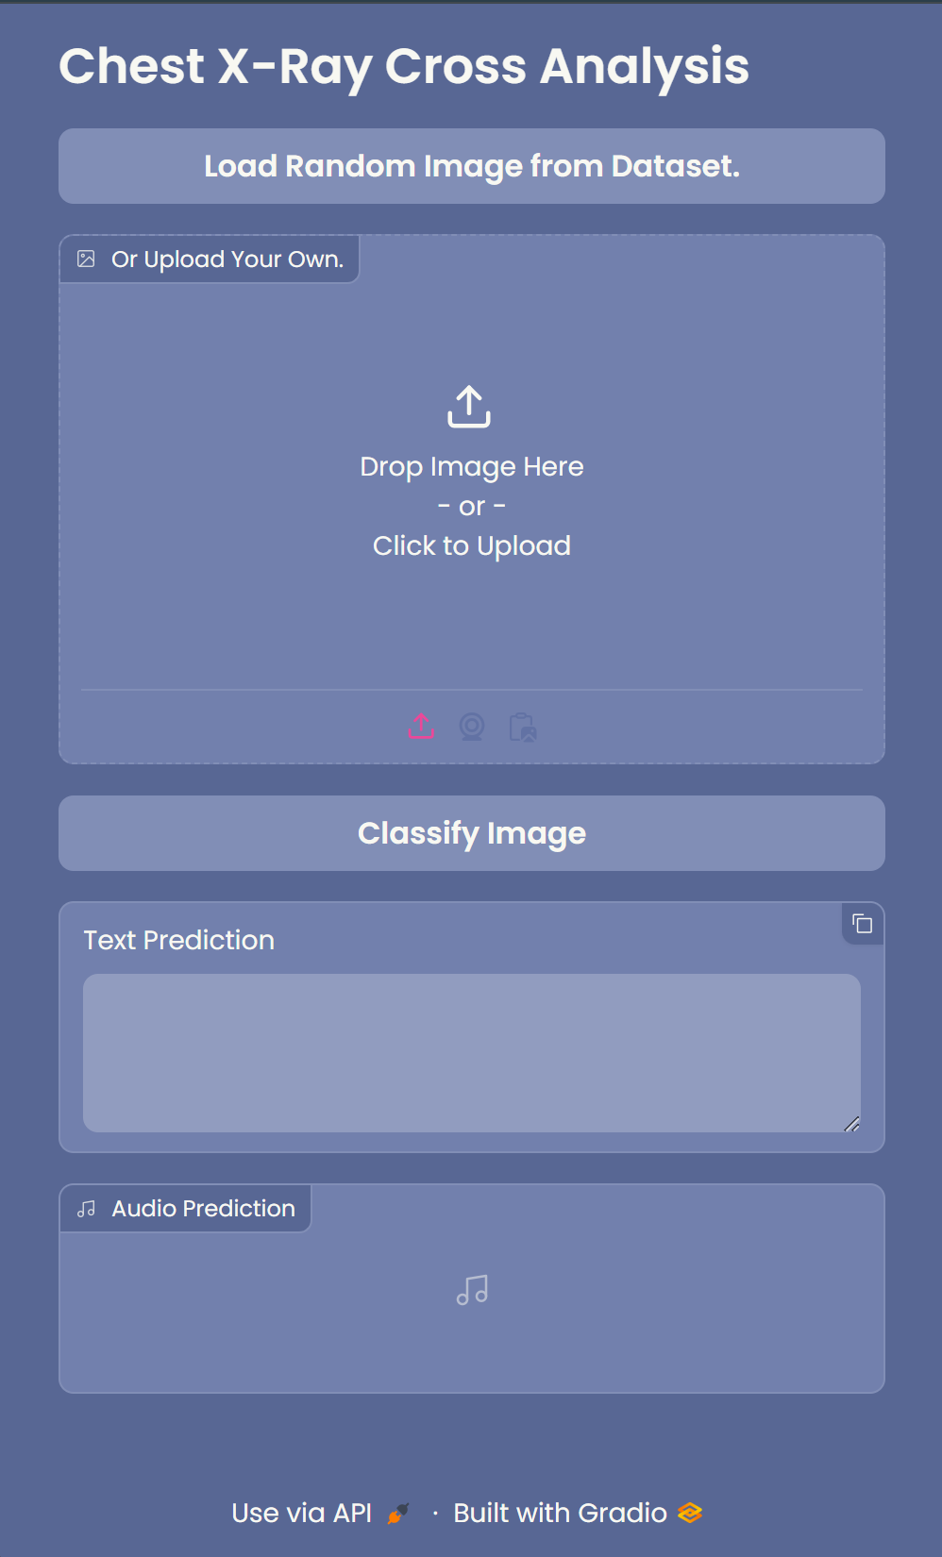
Demo
Notes:
Nathan

Slide 11
Challenges and Limitations
Time Constraints
Large Dataset
Iterative Training Times
Imbalanced Data
Specific Diagnosis vs Presence of Pathology
Limited Utility
Notes:
Nathan

Slide 12

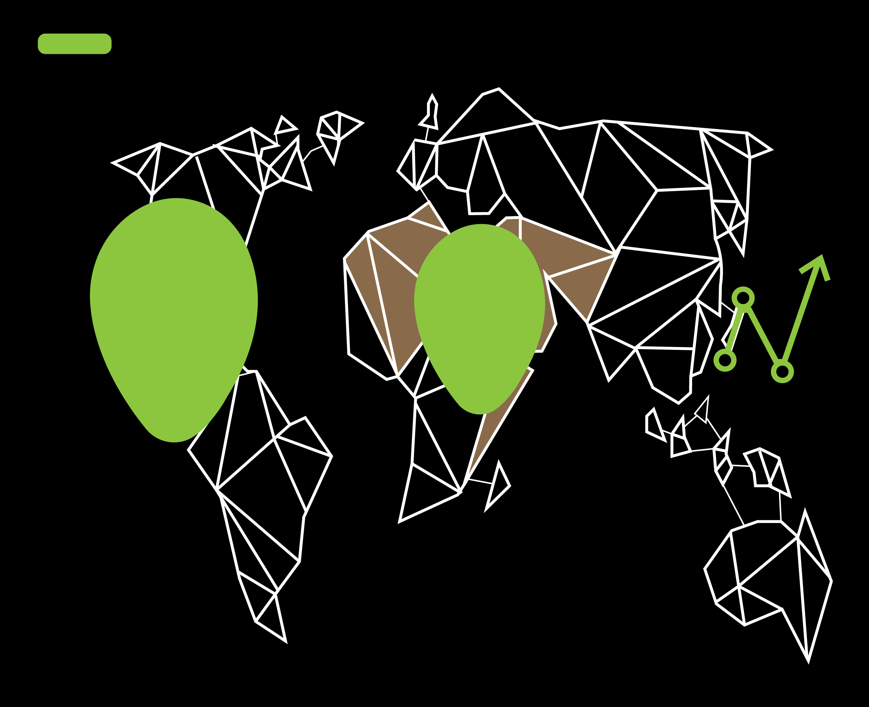
Market Size
66%
2032
$ 70 bil.
2024
$ 42 bil.
Market Size Growth
https://www.fortunebusinessinsights.com/industry-reports/medical-imaging-equipment-market-100382
Notes:
Bab

Slide 13
Future Scope
Cancer
Cardio
Open AI
TB
IOMT
Bone
Marrow
Extended Reality
Extended Health Care Categories
Extended Tech Stakes
PT
Scan
IOS/Android integration
MRI
Notes:
Bab

Slide 14
Questions?
Thank you

